Slide 1
Test SET optimization
Amir Avitan Stav Sapir

Slide 2
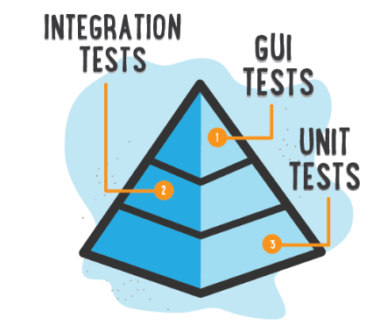


Motivation
Lots of code…
Need to test…
Many tests…Which should I choose?

Slide 3
Input
Software components (classes) with probability for having bug(failure).
Test pass trough 1…n software components (classes).
Each test has its joint probability for having bug(failure).
Each test has its joint probability for pass(success).
Real outcome of tests trace(0 –fail 1- pass).

Slide 4
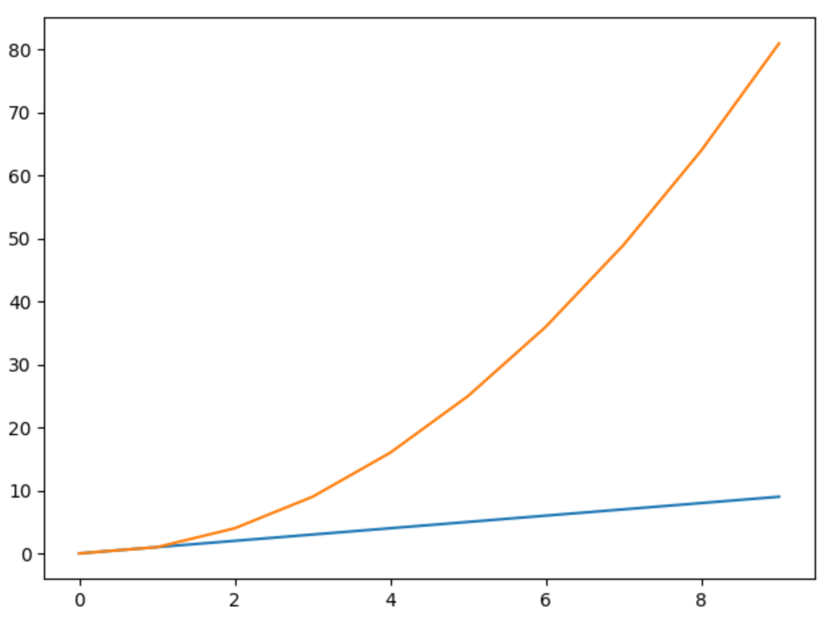

Target OUTPUT
Sub -Set of tests of constant size that maximizes the number of bugs.

Slide 5
Algorithm
For n number of tests to perform from N tests.
Calculate components failure entropy for all components.
Calculate components failure entropy for each test.
Simulate running the test with fail and pass outcome.
Calculate test components new failure probabilities using SFL diagnoser.
Choose the test with minimum entropy = maximum information gain given the previous tests already chosen.
Continue choose tests till reach n.

Slide 6
Algorithm - Test Entropy
Test Entropy = TestE1 + TestE2
Where :
TestE1 = success_probability(test) * success_entropy(test)
TestE2 = failure_probability(test) * failure_entropy(test)

Slide 7
Project Status
Done:
Data load into suitable data structures
Test entropy calculations implementation
Generate planning file for SFL diagnoser
Integrate SFL diagnoser and get updated priors
To be Done:
Verify correctness & test main iteration
Calculate chosen test max bugs
Compare chosen test Vs. simple top n failure test highest probability

Slide 8
Thanks!

